Slide 1

“We’re building more than a league. We’re building the future of the sport.”

Slide 2

The Future of Pickleball Team Competition
What is WTP?
The Future of Pickleball Team Competition
World Team Pickleball is more than a league. It’s where players, companies, and communities unite through the fastest-growing sport in America: building connection, visibility, and growth.
Players: All levels from Amateur to Professional.
Sponsors: Gain visibility, networking, and content.
Communities: Celebrate sport, wellness, and connection.
Business growth meets the fastest-growing sport in America.

Slide 3



Vision
WTP becomes the global pickleball hub where players get live DUPR updates, earn WTP Ranking points, join drafted teams, and engage on a unified social platform.
ROADMAP
2028+ Global hub
Q4 2025 Launchpad
International stops, App V3 social features, ads and live streams scale, goals 500k players, 1k venues, 20M monthly sessions.
Oct 18 at TTC Newport Beach, full bracket and first venue case study with App V1 live.
2027 National Platform
20–30 events with city circuits and finals, sponsor draft players onto teams like fantasy football, membership and shop live, goals 100k players, 5M impressions per event.
Momentum to date
We showcased the WTP model during Super Bowl week through a Michelob Ultra activation that proved sponsor demand and delivered national visibility.
2026 Prove Scale
8–12 events, DUPR sync and WTP Ranking in App V2, Sponsor Toolkit V1, goals 10k players, 25 packages.

Slide 4

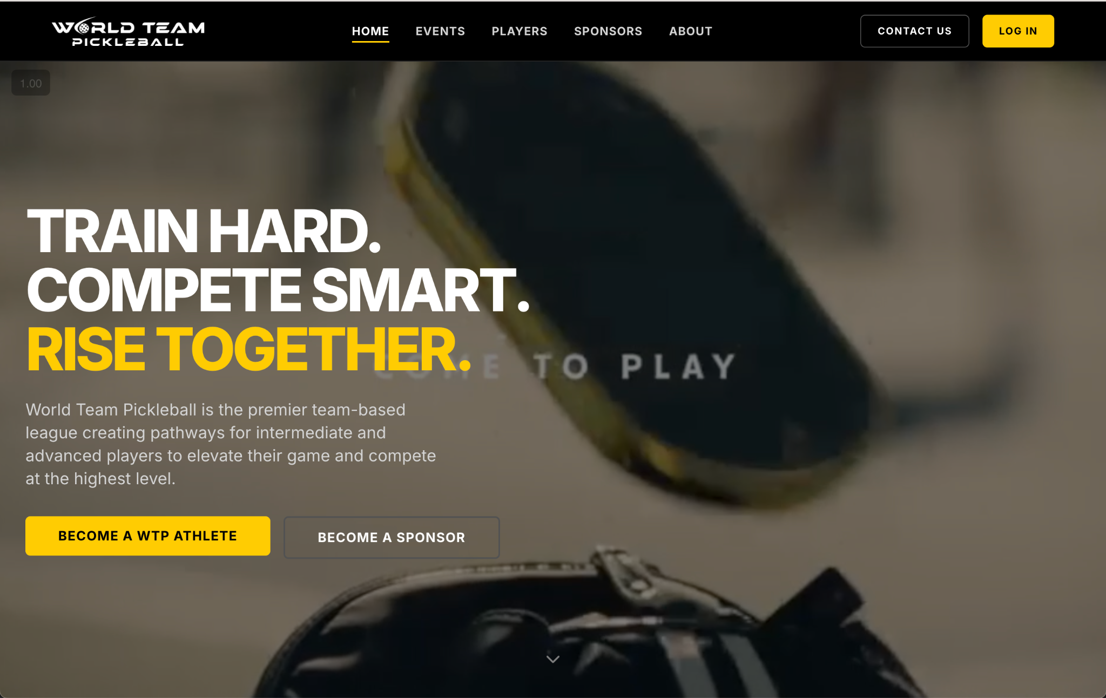
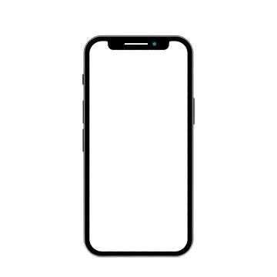
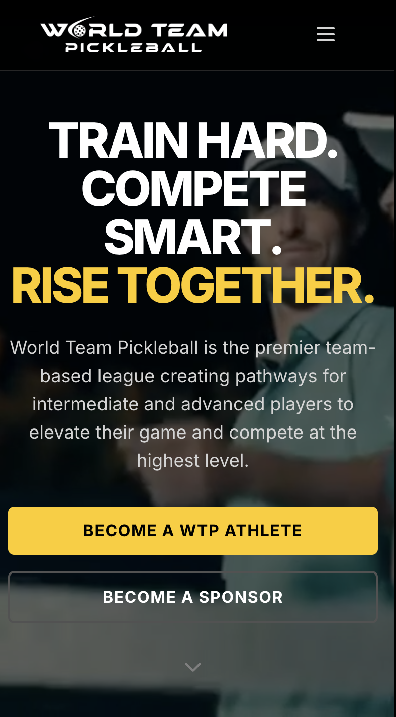
Player Database
Event Engine
Stores level, city, interests, and play history. Can segment and message the right groups.
Registration and scheduling in the app; runs round robin, ladders, and team formats. Live scoring and payouts.
Rankings & Identity
Sponsor & Team Marketplace
Unified ratings and season points; builds storylines and badges. Can spotlight streaks and milestones.
Sponsor tools in the app; create teams for a day, draft pools, and activations. Can track impressions and ROI.
Venue Toolkit
Shop & Memberships
The Platform
We are building more than just a league, we’re creating a digital home for the pickleball community.
Venue pages in the app; calendars, court maps, staffing, and inventory. Can share revenue with partners.
Incorporated shop in the app; can embed your products and prompt them on the app.

Slide 5
Why Brands Partner with World Team Pickleball
Massive Reach
Authentic Engagement
Brand Alignment with Lifestyle
Flexible Activation Opportunities
Pickleball is one of the fastest-growing sports in America, with 36M players and a 159% participation jump since 2019. Partnering with WTP gives brands instant visibility in a sport with unstoppable momentum.
WTP builds real fan connections through tournaments, social activations, and grassroots events. With 3–4x higher engagement than industry norms, sponsors interact directly with passionate communities.
Pickleball is a wellness-driven culture, not just a sport. 70% of players rank fitness and health as their top priority, making WTP a natural fit for lifestyle, nutrition, and health brands.
Every partner has unique goals. WTP offers custom activations that drive measurable results, with recent sponsor campaigns showing 25–40% lifts in trial and awareness.

Slide 6




Trusted By
Leading Brands
And growing…..

Slide 7
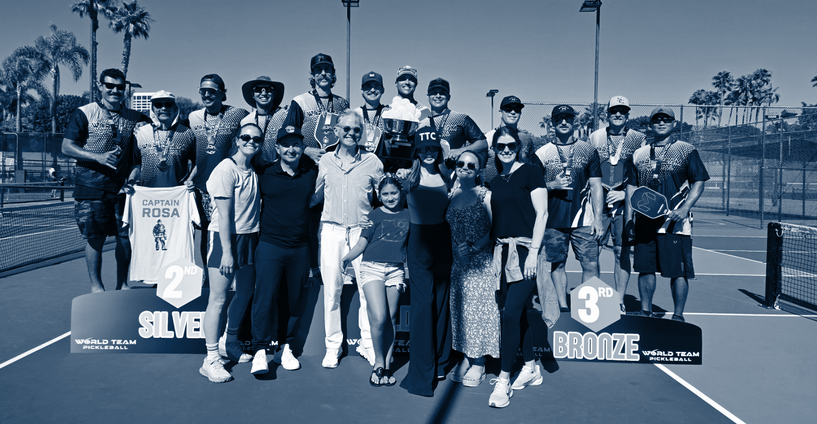
The Right Sport
at the Right Time
Pickleball isn’t just growing, it’s exploding. With 20M+ U.S. players, 40% year-over-year growth, and participation nearly doubling in the past three years, World Team Pickleball captures this unprecedented momentum. Brands that align now ride the wave of the fastest-growing sport in America, connecting with a community that values energy, wellness, and shared experiences.
Momentum is everything: this is a once-in-a-generation cultural movement, and WTP places your brand at the center of it, giving you front-row access to growth, visibility, and impact.

Slide 8
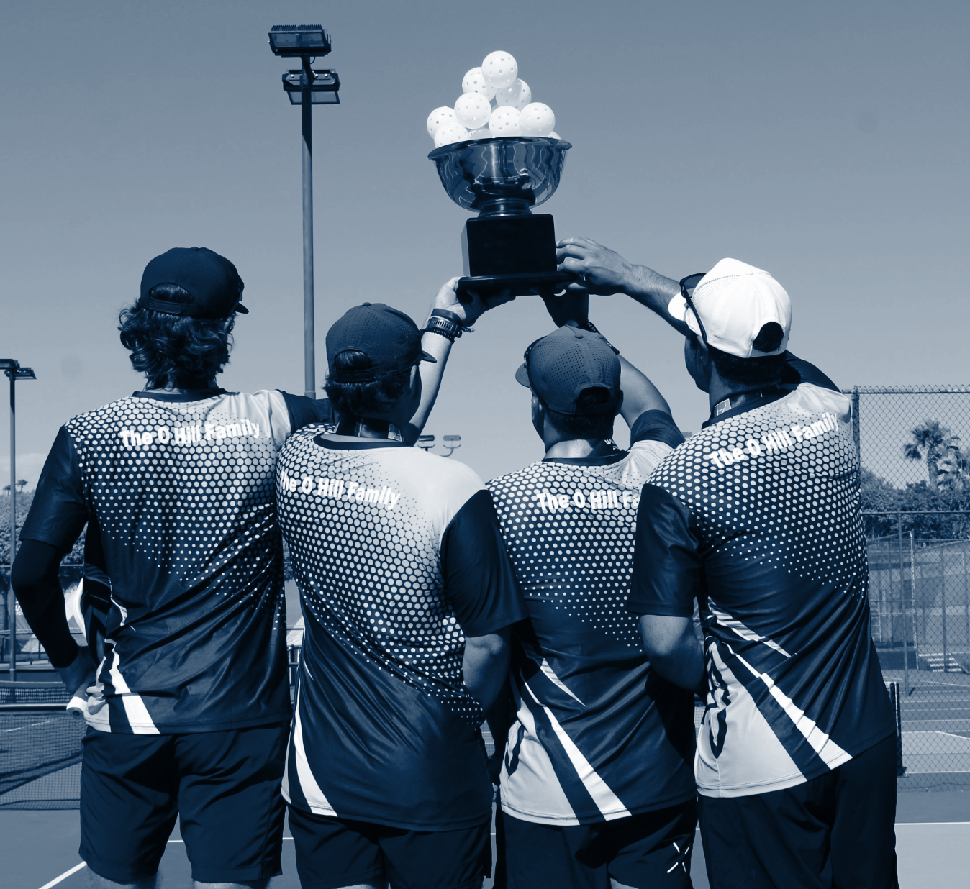
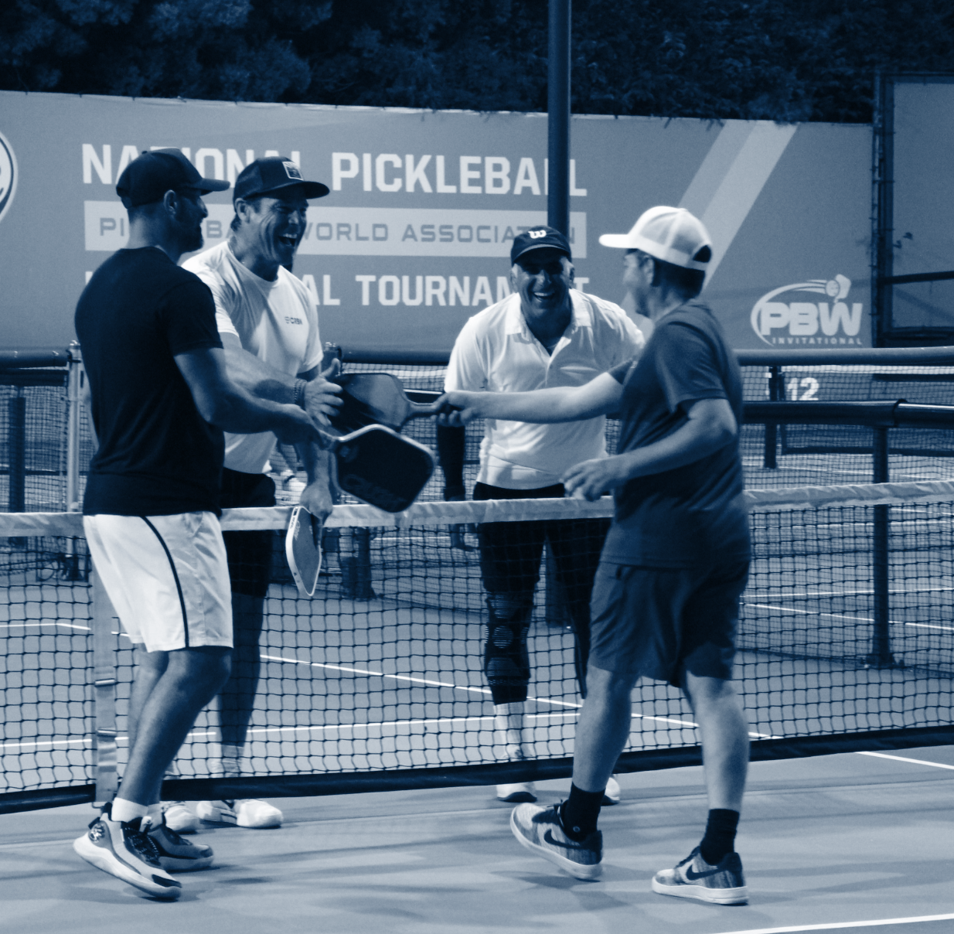
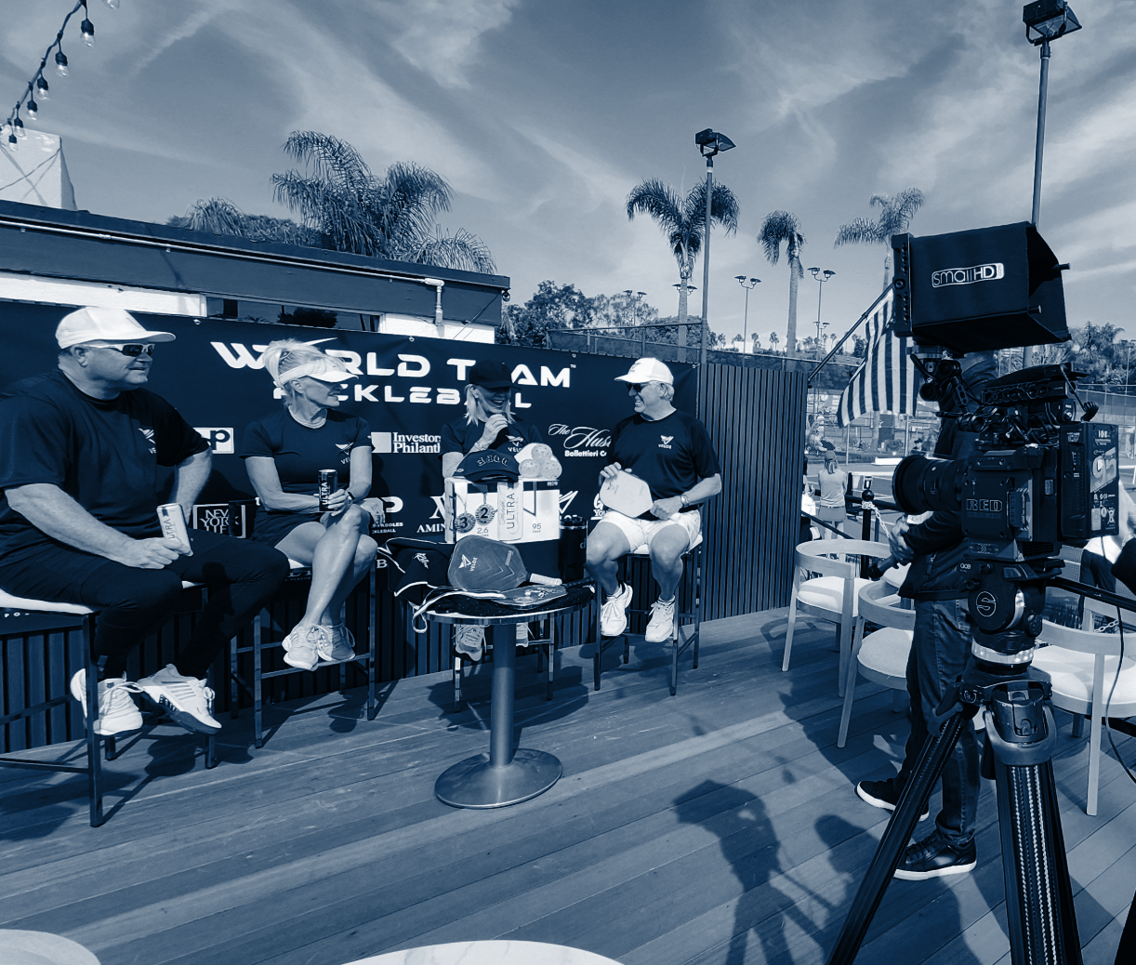
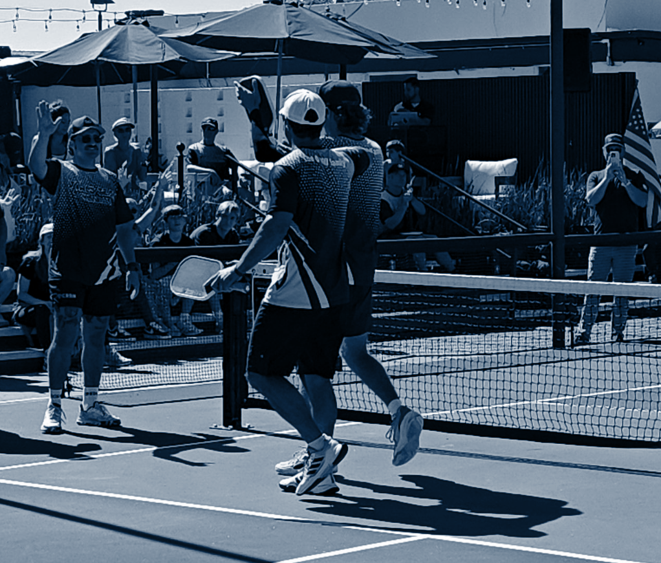
Community &
Cause Alignment
World Team Pickleball gives brands the chance to stand for more than competition. Enjoy exposure in the context of purposeful play, aligning with nonprofits, charities, and local community initiatives.
Sponsor-driven events reinforce corporate social responsibility: supporting health, wellness, and community engagement while strengthening brand reputation.
Through local tournaments, charitable tie-ins, and volunteer programs, your brand becomes positively rooted in community energy and impact.

Slide 9
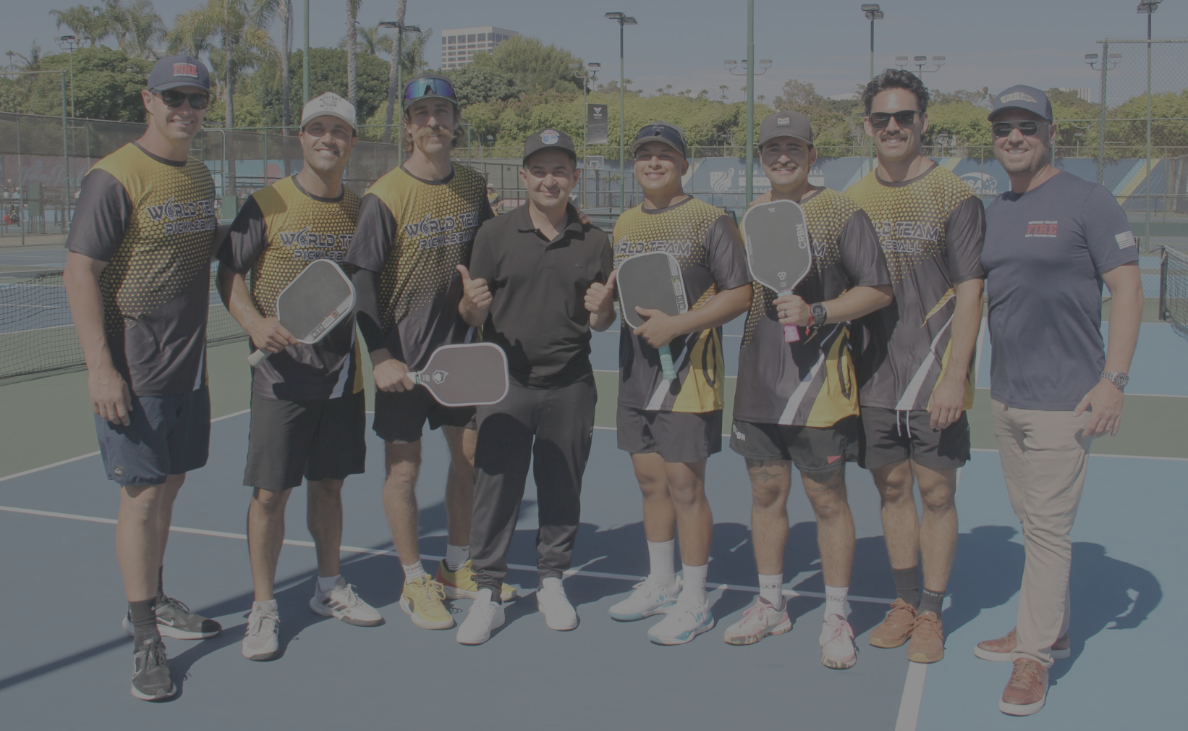
Our Vision
Our Mission
World Team Pickleball fosters authentic connections by creating experiences that blend sport, community, and business. We aim to be the premier platform where employees, clients, and executives can build lasting relationships on and off the court.
To engage people through the fastest-growing sport in America, offering unique opportunities for team building, client appreciation, and meaningful networking that extends beyond the game.

Slide 10
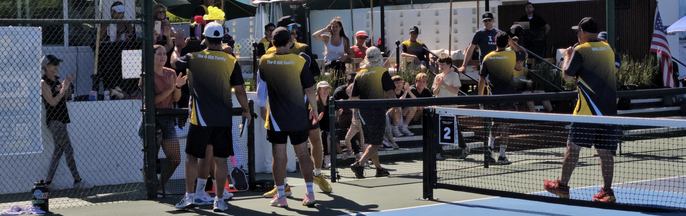
World Team Pickleball creates sponsorships that go beyond logos. Partners are woven directly into the experience — on jerseys, courts, broadcasts, and digital platforms. Every event becomes brand content, with professional photo and video coverage built to amplify reach.
WTP turns sponsorship into storytelling, giving companies the chance to connect with fans, athletes, and business leaders in ways that last far beyond the match.
Sponsorship &
Brand Content

Slide 11
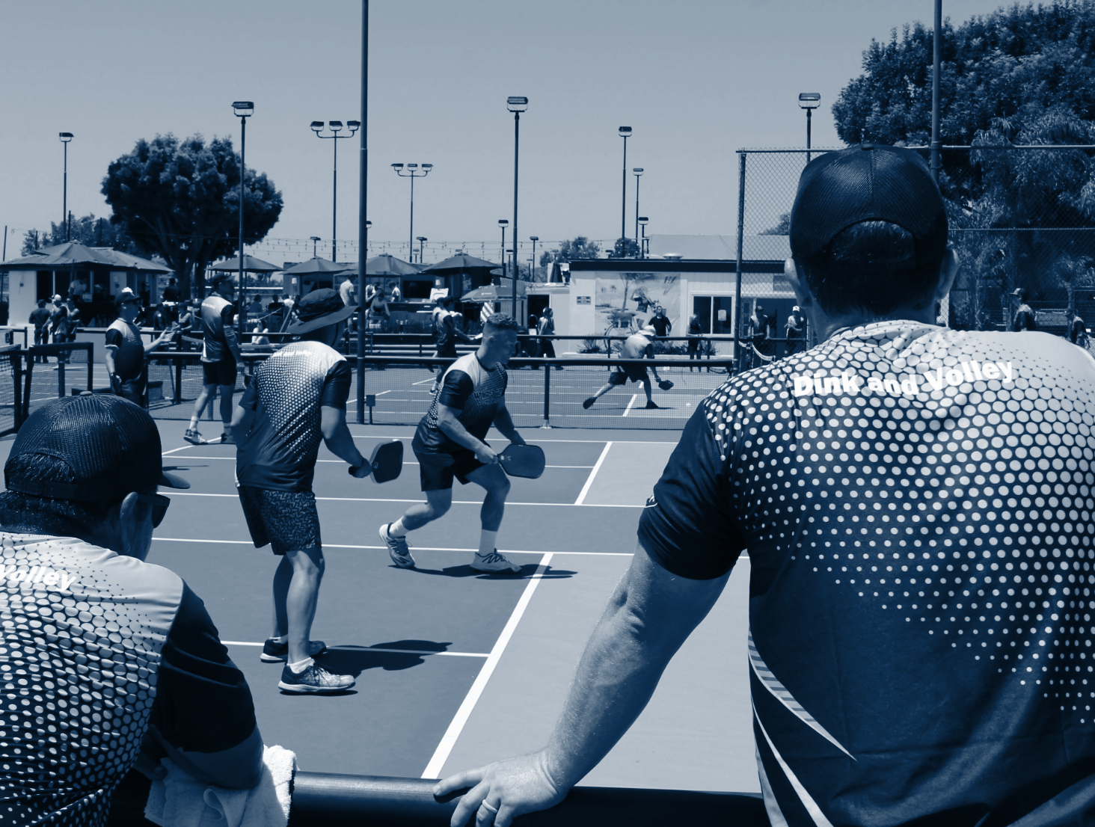
Incredible
Networking
Opportunity
World Team Pickleball events are designed as much for business connection as for competition. Each gathering brings together executives, entrepreneurs, and community leaders who share the court, build relationships, and expand their networks in a dynamic, energetic setting.
WTP creates authentic conversations through shared experiences, from team play to VIP hospitality. Every match doubles as a lead-generation platform, positioning sponsors directly in front of decision-makers who are engaged, collaborative, and ready to partner.
20M+ U.S. pickleball players

Slide 12
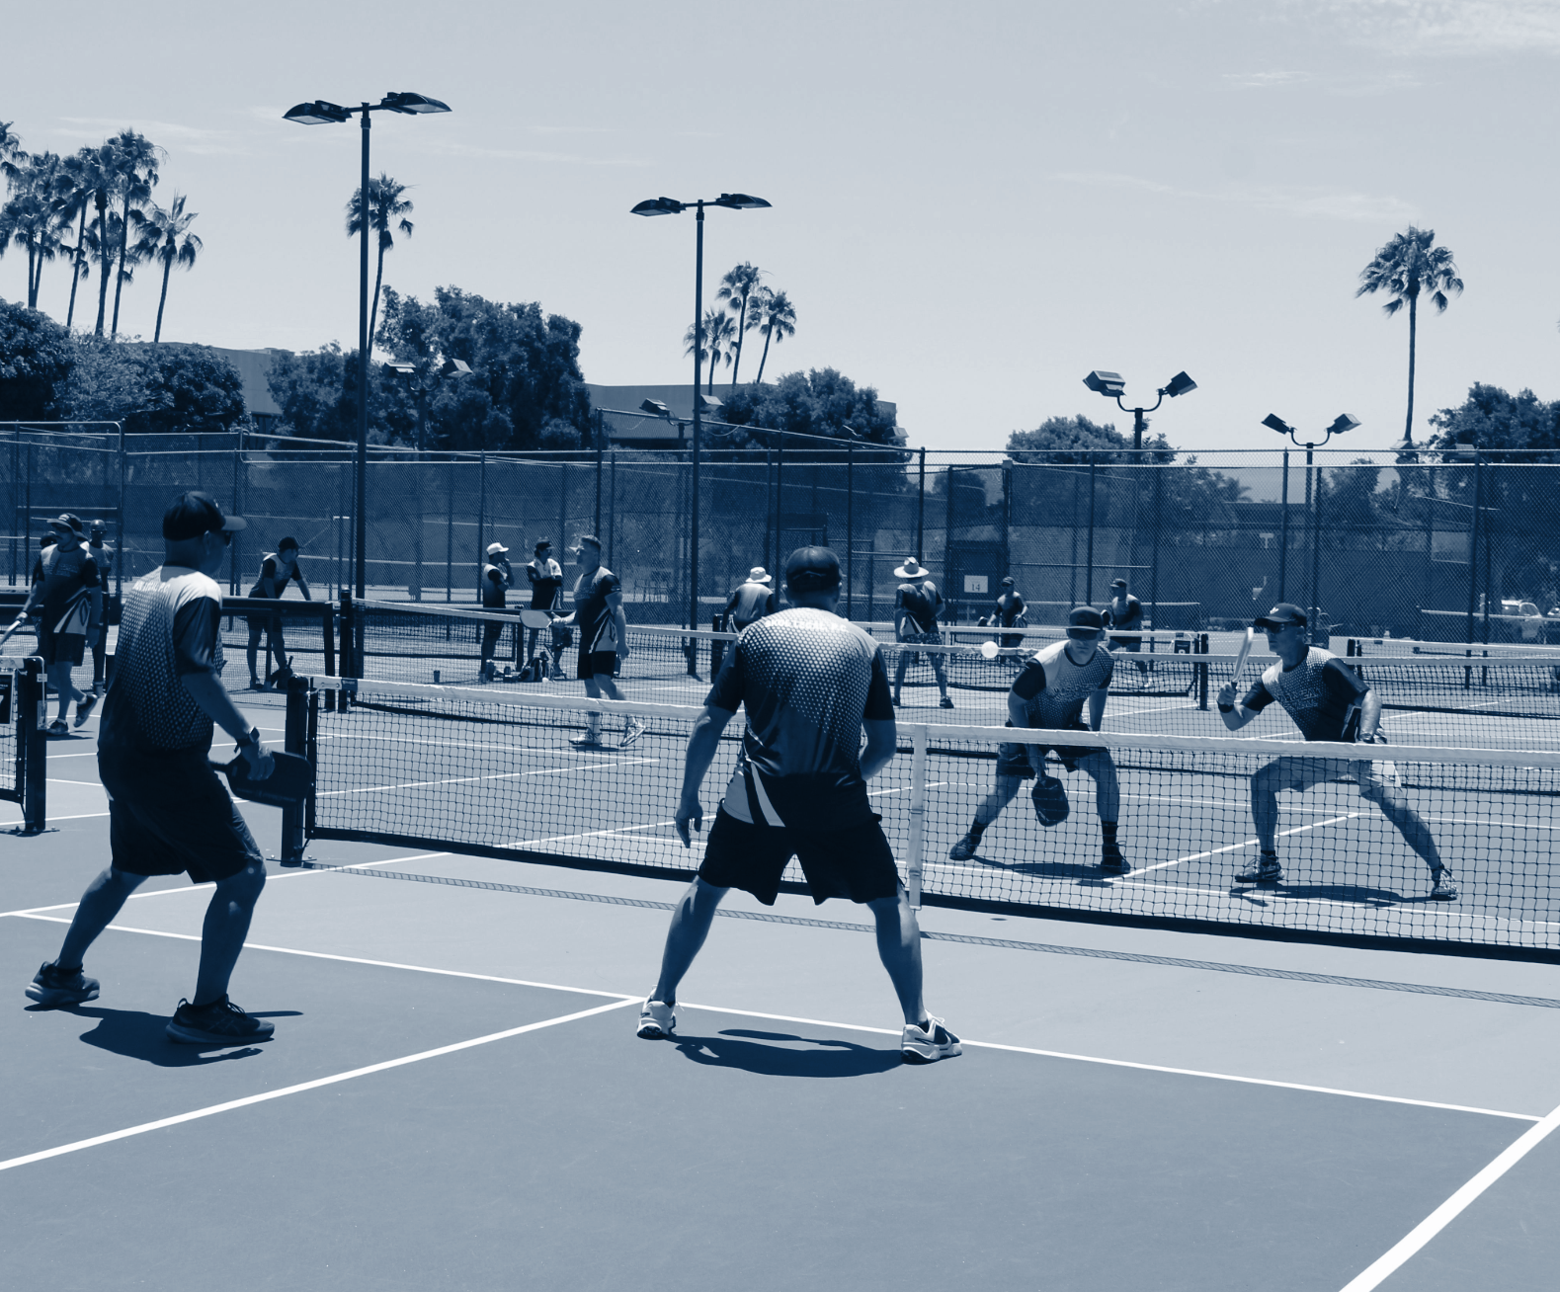
Why Partner
with WTP?
More Than Sports: A Business Growth Platform
Brand Visibility
Jerseys, signage, courts, media coverage
Lead Generation
Direct access to executives and decision-makers
Content Creation
Professional media packages for your brand
Momentum
Early entry into the fastest-growing sport in America

Slide 13

Thank You

